Slide 1
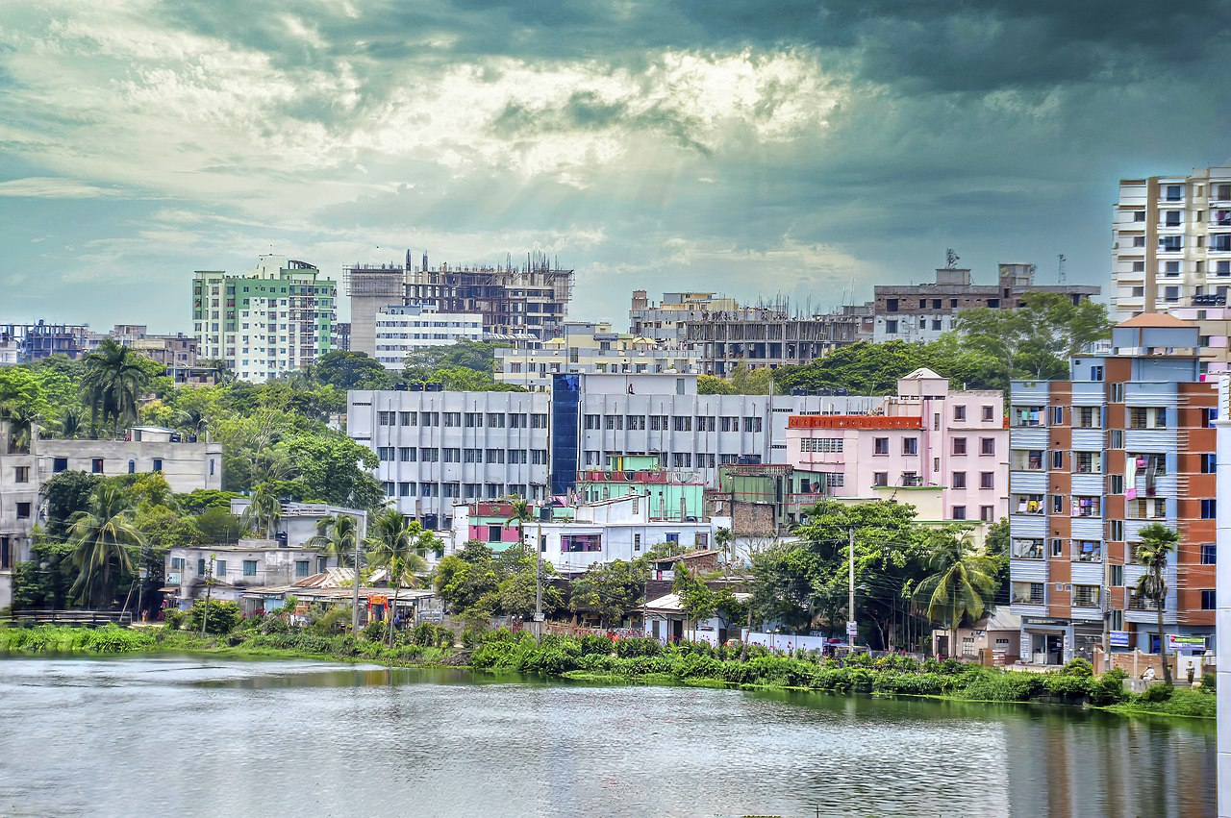
HOMETOTWN CUMILLA
RIPA RANI BIWAS
Reg. no. – 20201001
Department of computer science and engineering
University of Asia pacific

Slide 2
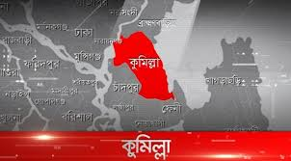
LOCATION OF THE CITY
Comilla District is located about 100 kilometers south east of Dhaka.
Brahmanbaria and Narayanganj districts to the north.
Noakhali and Feni districts to the south.
Tripura of India to the east.
Munshiganj and Chadpur to the west.

Slide 3
HISTORY OF CUMILLA DISTRICT
Cumilla district was established as the Tripura district in 1790.
It was renamed Cumilla in 1960.
Cumilla is the second-largest city of eastern Bangladesh after Chittagong and is one of the three oldest cities in Bangladesh.
Cumilla is one of the three oldest cities in Bangladesh.
Cumilla was part of the kingdoms of Pala and Chandra dynasties and samatata janapada.

Slide 4
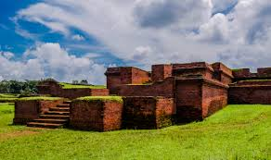
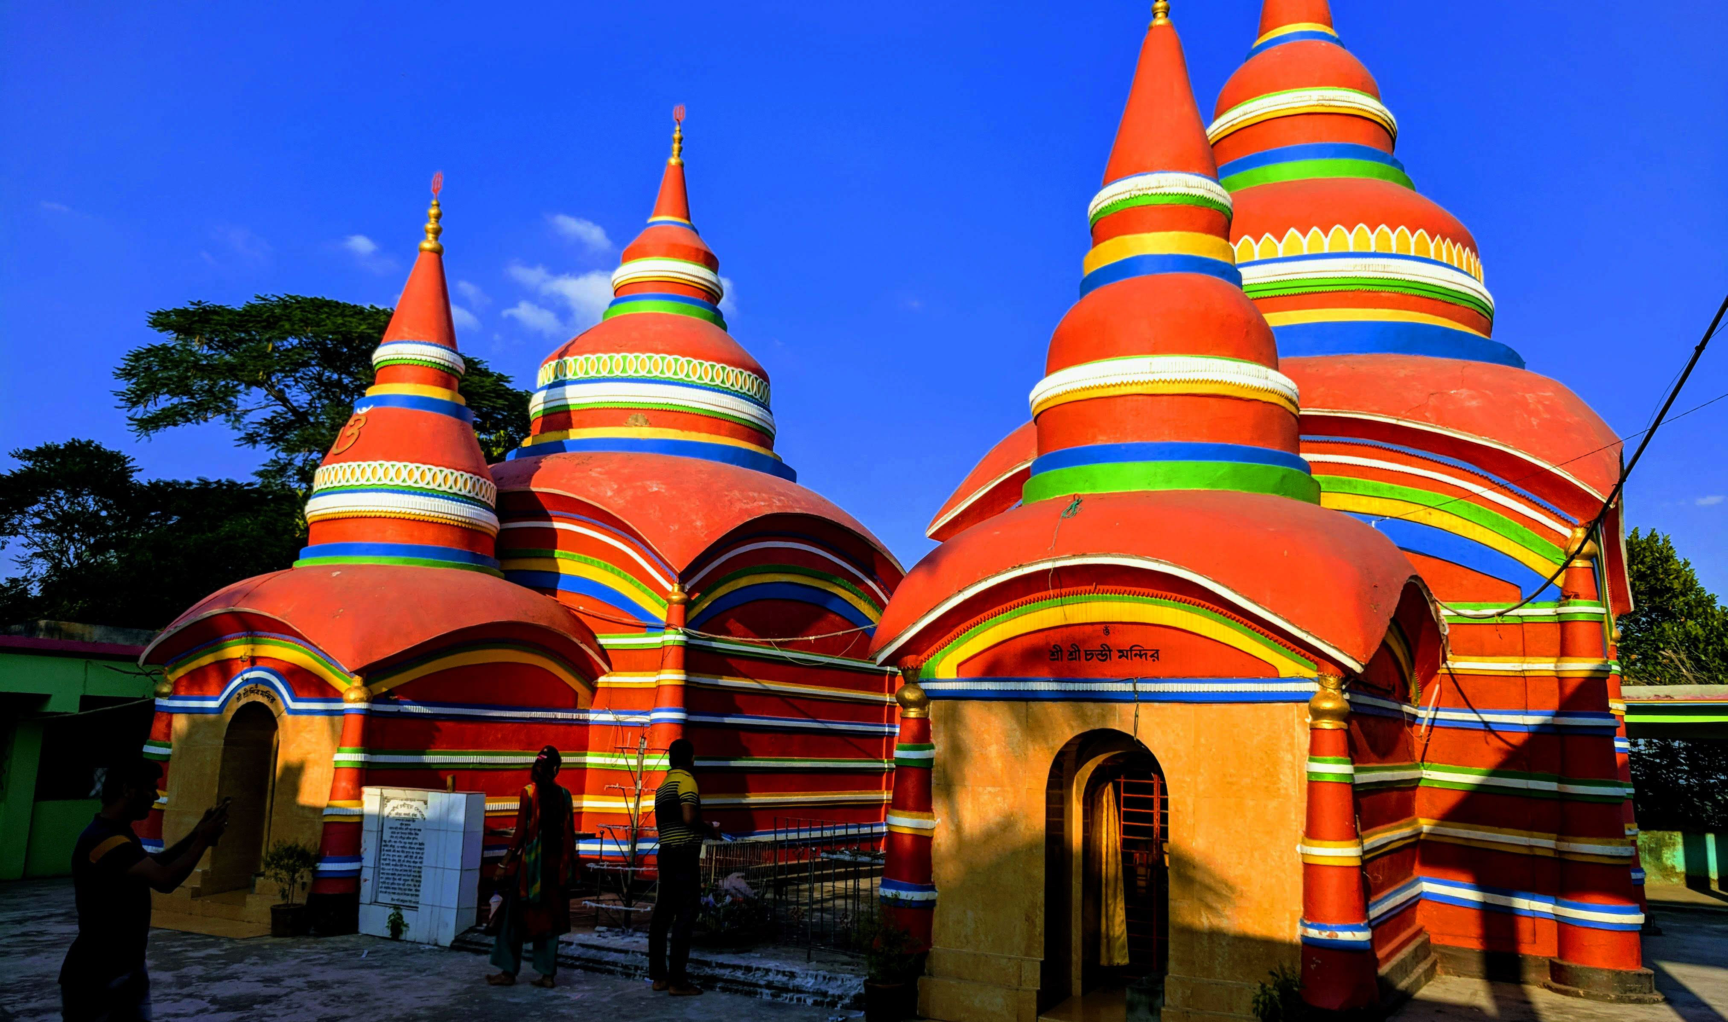
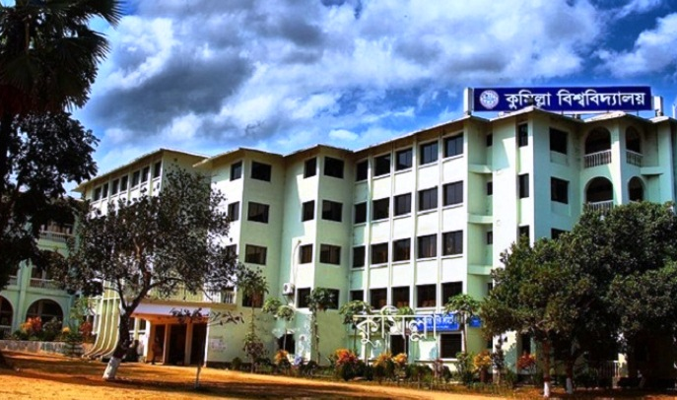
HISTORICAL PLACES OF CUMILLA
CHONDI MURA TAMPLE
CUMILLA UNIVERSITY
SHALBAN BIHAR
It is an archaeological site in Mainamoti , Comilla.
This Temple is at the southern end of the Lalmai Hill,Cumilla.
It is a public university located at Kotbari, Cumilla,

Slide 5
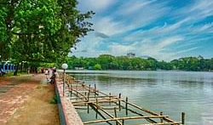
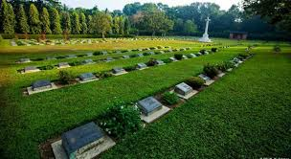
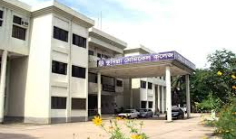
HISTORICAL PLACES OF CUMILLA
DHARMO SAGOR PARK
Mainamati War Cemetery
CUMILLA MEDICAL COLLEGE
. The pond was dug by the Tripura king Dharma Manikya I in 1458
The cemetery contains 736 Commonwealth burials of the Second World War.
Comilla Medical College is a government medical school near Kuchaitoli in Cumilla.

Slide 6
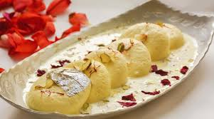
FAMOUS THINGS OF CUMILLA
Rosh malai, a milk sweet, of Matri Bhandar, located beside Comilla Kandirpar, is famous in Bangladesh.
(If you visit the district, then you must get some sweets from there.)

Slide 7
POPULATION OF CUMILLA
YEAR | POPULATION
2021 | 609,000
2020 | 589,000
2019 | 569,000
2018 | 549,000
2017 | 530,000
2016 | 493,000
2015 | 486,000
2014 | 478,000
2013 | 469,000
2012 | 450,000
2011 | 445,000
2010 | 425,000

Slide 8
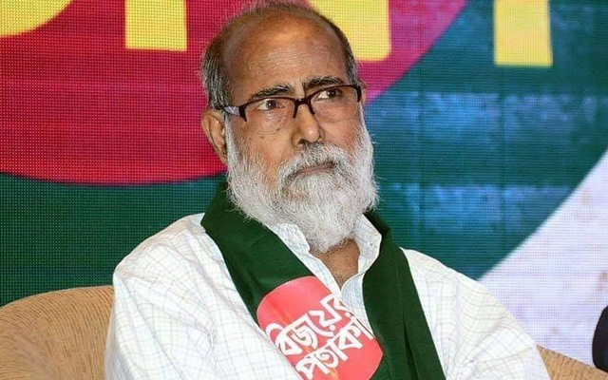
FAMOUS PERSONALITY
SHIV NARAYAN DAS , member of BLF, one of the designers of the first Flag of BANGLADESH in 1971, a freedom fighter and political activist.

Slide 9
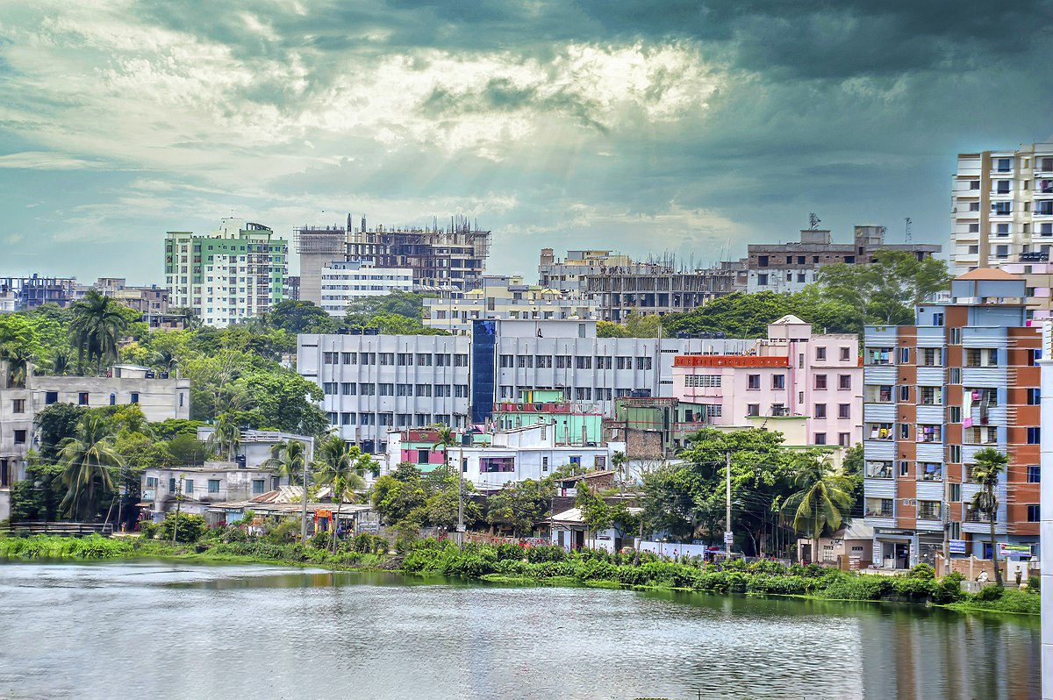
OUR CUMILLA OUR PRIDE

Slide 10
THE END
THANKS FOR WATCHING

